Slide 1
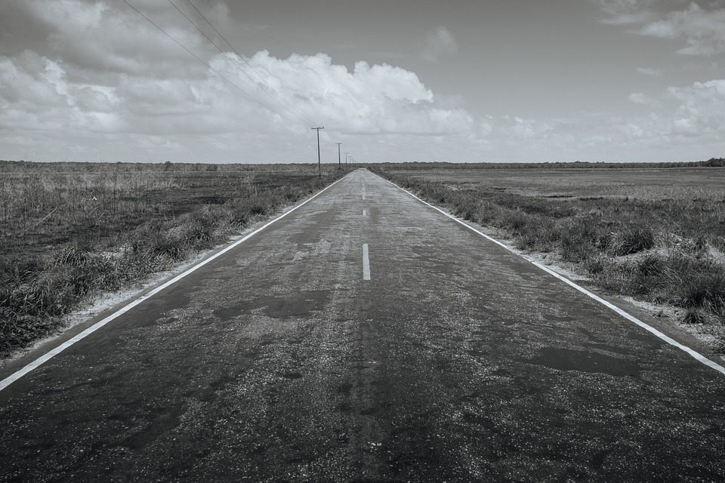
Eighth-Grade Language Arts Course Syllabus
2017-2018
Centennial Magnet Middle School
Mrs. Shanna Joseph www.sjoseph@wcpss.net
Google Classroom: d4xlv09 Remind code: @mzjoseph16 www.shannajoseph.weebly.com
Students in English Language Arts 8 will apply reading, writing, listening, speaking, and viewing skills in an independent manner through meaningful interdisciplinary tasks. Students will continue to develop an appreciation for literature as well as build vocabulary through the study of literary elements in classic and contemporary selections. We will focus on moving from the literal to the abstract in both critical thinking and writing skills.
WHAT WILL WE BE LEARNING?
UNIT 1: JOURNEYS | UNIT 2: RIGHTS AND RESPONSIBILITIES | UNIT 3: RISKING IT ALL | UNIT 4: THE POWER OF LANGUAGE
What inspires people to embark on journeys? How are people shaped by their journeys? How do readers use textual evidence to support analysis? How does an author’s purpose, intended audience, and point of view impact meaning? | How do choices and life experiences cause one to mature? How do authors use narrative elements to create effect? How is theme developed through a combination of literary devices? How does textual analysis help readers determine implicit and explicit meaning of a text? | What motivates people to take risks? What are the consequences of taking/not taking risks? How does word choice affect tone, meaning and mood? How does text structure affect meaning? How can point of view affect argument? | How does language define who we are as members of society/culture? How does language create dissonance? Harmony? How can language influence our perception of ourselves, others, and the world around us? How can language be used to persuade or make an impact on an audience?

Slide 2
Missing work is defined by work that is not turned in due to an absence.
Missing work will be accepted for one week after its original due date.
Late work is defined as work that is not turned in on time not as a result of an absence.
Late work will be accepted for one week after its original due date.
MISSING AND LATE WORK
POLICY
HOWL EXPECTATIONS
It is the expectation that students HOWL during their time at Centennial and in Mrs. Joseph’s class. To HOWL means to display the following attributes:
Honor
Order
Wisdom
Leadership
HOWL expectations are part of our school wide PBIS plan; more information can be found on the CCMMS website.
GRADE DISTRIBUTION
Major Assignments 60%
Unit Projects/Tests/Essays
Minor Assignments 40%
Quizzes/Journals/Classwork
SUPPLY LIST:
Composition Notebook
Headphones
Section for ELA in Binder
Pencils (Mechanical Preferred, 0.7)
WISH LIST:
-Tissues
-Clorox Wipes
-Lined Paper
-Hand Sanitizer
-Markers and Colored Pencils
-Board Games
-Gift Cards

Slide 3
PARENT CONTACT FORM
Parent and teacher communication are essential for a student's success in the classroom. I would love to keep parents up to date on happenings in the classroom and awesome student behavior! If you were not able to fill out the Parent Contact form at Open House, please take a moment to fill out the form below!
Student Name:____________________________________
Contact One Name:_________________________________
Contact One Phone Number:__________________________
Contact One Email:_________________________________
Contact Two Name:________________________________
Contact Two Phone Number:__________________________
Contact Two Email:________________________________
Parents and Students,
Please sign and return this sheet when you have reviewed syllabus information and have filled out the Parent Contact Form!
Parent Signature:____________________________________
Student Signature:____________________________________

